Slide 1



Integrated Program in Business Analytics
Dream 11 Fantasy
Team Prediction
Group G
Group Members :
Anushka Singh
Gaurav Babbar
Himanshu
Kanisha Shah
Khushi Jasrapuria
Prakhar Mohan
Yogesh Arora
Mentor: Suraaj Hasija

Slide 2
Agenda
Business Problem and Objectives
Executive Summary
Data Overview and Key Business Assumptions (if any)
Data Preparation and Pre-processing
Sanity checks, treatment and transformations for analytical dataset preparation
Exploratory Data Analysis
Key Business Findings and Insights
Model Development and Validations
Model comparisons on key scoring metrics and model finalization
Dashboarding (required only when it is in scope of analysis)
Businesss Recommendations and Potential Business Impact
Next Steps
Appendix

Slide 3



Business Problem and Objectives
Indian Premier League and Dream 11 (Fantasy Sports)
Cricket Fever in India and thus, exponential Rise of IPL in recent years
Increase in popularity of fantasy games in India, and Dream 11 is the torchbearer of this change
Dream11 is a fantasy sports platform where cash contests are organized and contestants need to select 11 players out of the total 22 playing players for each match and earn maximum points to win maximum rewards
Increasing the customer base of Dream 11 by attracting new customers who have less knowledge on cricket
Encouraging the existing customers to participate in more competitions and earn rewards by providing an add on feature of helping them to create their team which has higher chances to win
To analyse the past performance of each player from 2008 to 2020, and create a recommendation system, that gives the top 11 players for each IPL team as an add-on feature of Dream 11

Slide 4

Executive Summary
Background
Fantasy Sports
Objective
Recommendation System
Customer - Maximize rewards
Business - Increase Customer Base and Potential Revenue
Dream 11
Linear Regression
Weighted Average
Results
Minimal Error
Linear Programming Problem
Predicts the Best Playing 11 considering all the Dream 11 Constraints
Conclusion
Customers would be attracted to try out this new feature as an additional help and maximize their rewards.
IPL
Methods
Company can expand their customer base.

Slide 5
Data Overview
Data source: IPL Match data from 2008 to 2020 from Kaggle
Ball by Ball Information For each Match from 2008 to 2020.
Match Information regarding the venue, date, umpire, toss decision, player of the match, winner teams, etc.
34 Variables
193k Values
13 IPL Seasons
816 Matches
11 IPL Teams
518 Players

Slide 6
Data Preparation and Pre-processing
Team Name Alignments due to different franchise names in season
Creating variables according to Dream 11 point calculation
Aggregating Batsmen and Bowler Data
Distinguishing players into Batsmen, Bowler and All-Rounder (Playing Role)
Null Value Treatment
Removing players who have played less than 5 matches
One-Hot encoding

Slide 7
Correlation Matrix

Slide 8
Exploratory Data Analysis
Matches Played By teams and Wins
Toss Decision
Matches Won by Wickets and Runs
Top Batsmen and Orange Cap Holders
Top Bowlers and Purple Cap Holders
Man of the Match for Each Season

Slide 9
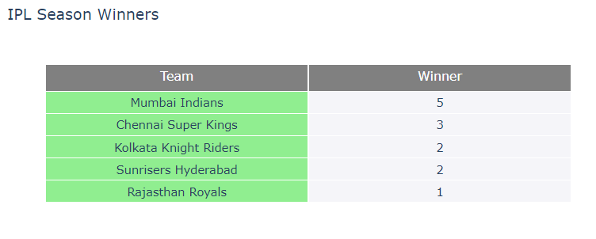
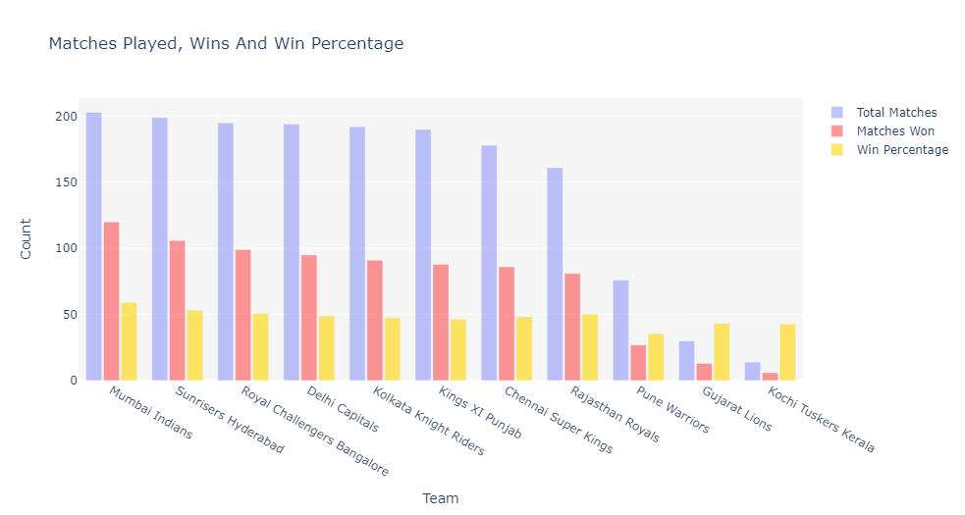

No. of IPL Seasons Won by Each Team
Team Analysis
Top Teams:
1. Mumbai Indians - 203 Matches (120 Won) – 59%
2. Chennai Super Kings – 178 Matches (86 Won) – 48%
3. Kolkata Knight Riders - 192 Matches (91 Won) – 47%

Slide 10
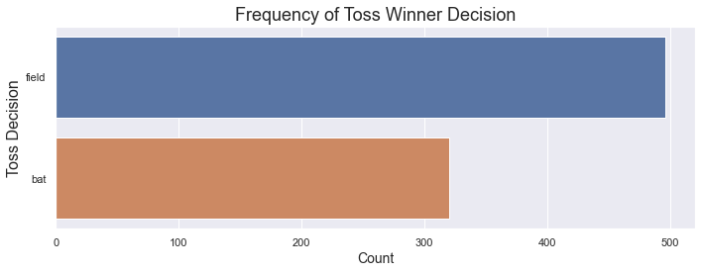
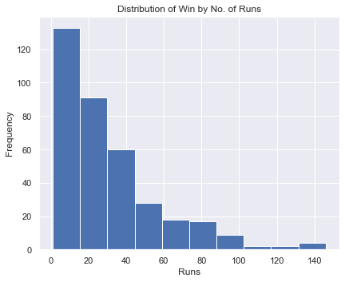
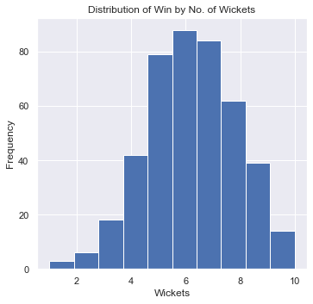
Toss Decision and Matches Won
No. of Matches Win by Wickets = 435 matches
No. of Matches Wins by Runs: 364 Matches
Win by Maximum Runs - 146 runs
Win by Maximum Wickets – 10 wickets

Slide 11
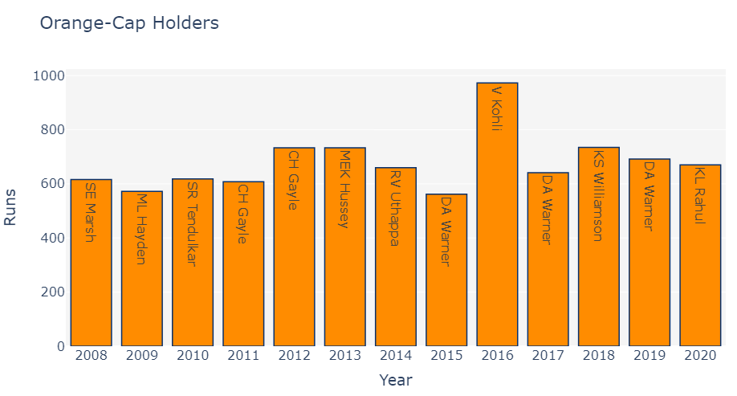
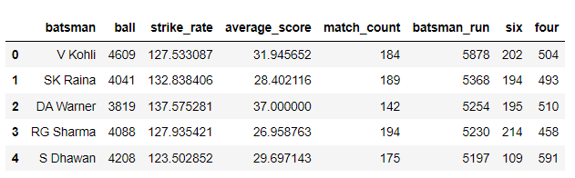
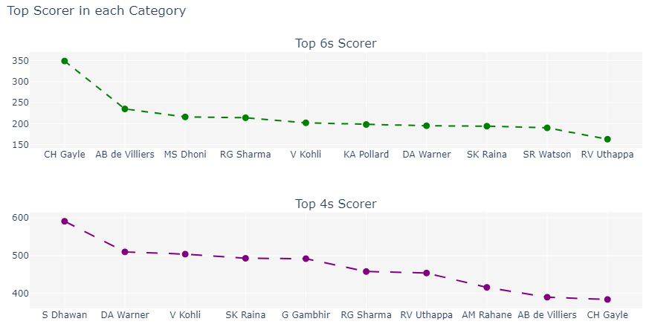
Batsmen Analysis

Slide 12
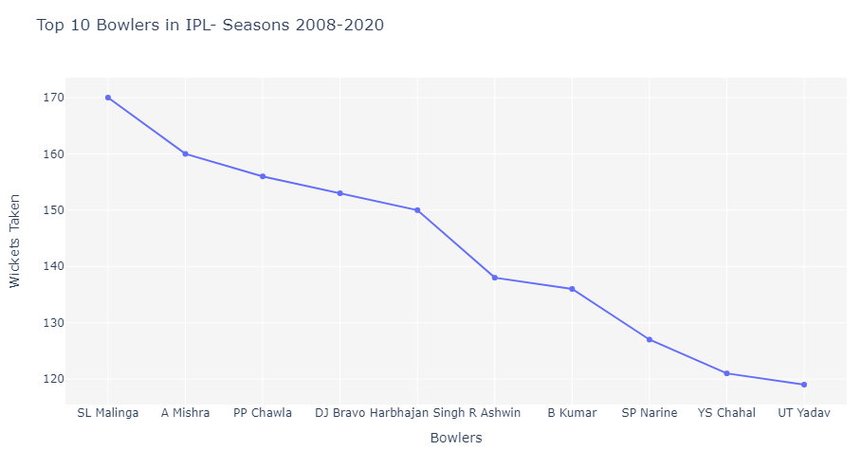
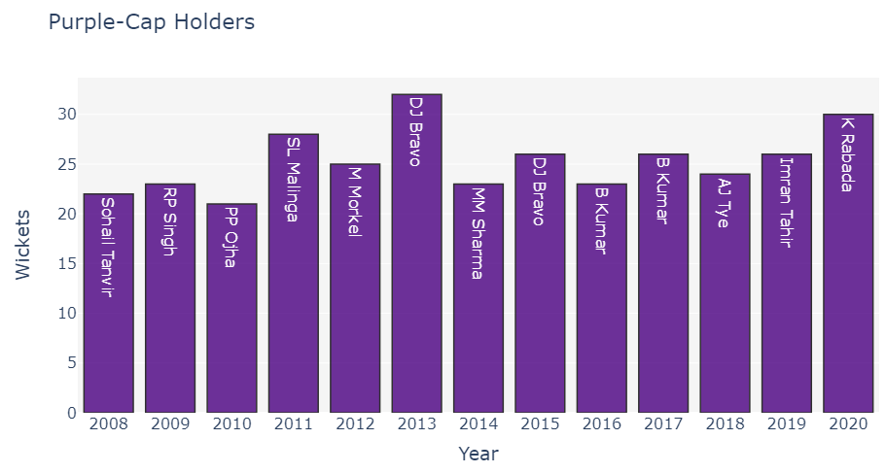
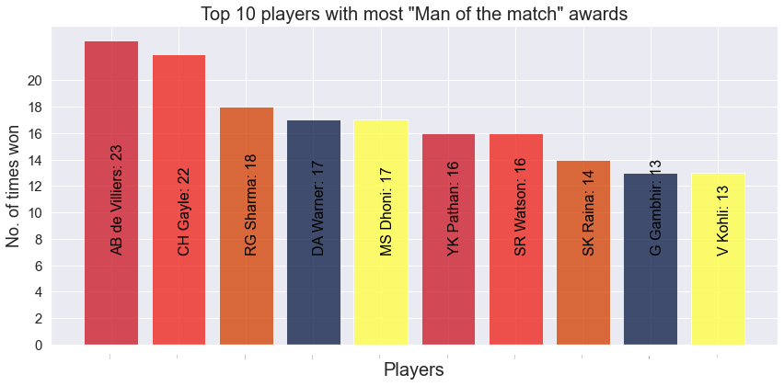
Bowler Analysis
And
Man of The Match

Slide 13
Model Development and Validations

Slide 14
Linear Programming Problem

Slide 15
Business Recommendations and Potential Business Impact
Expansion of Customer Base
Potential Revenue driver
Customer Retention
Competition to other rival fantasy sports apps

Slide 16
Next Steps
Including data of players from other tournaments also for increasing the prediction accuracy.
Adding more Constraints
Adding more variables for player prediction
Introducing Subscription model for the Top 11 players
Expanding the solution to other team sports and Fantasy Sports Apps

Slide 17
Appendix
References: IPL Dream11 Winner Team Prediction 2021 | Kaggle
Data Dictionary
Id - Unique Match ID as per ESPNCricinfo
Inning - Inning Number
Over - Over Number
Ball - Ball Number
Batsman - Batsman on strike
Non_striker - Batsman at non-striker
Bowler - Bowler
Batsman_runs - Runs off bat
Extra_runs – Extra no. of runs
Total_runs - Total no. of Runs
Non_boundary - If there are overthrows
Is_wicket - Is the delivery a wicket?
Dismissal_kind -Type of dismissal
Player_dismissed - Player who got dismissed
Fielder - Fielder involved in the dismissal
Extras_type -Type of extras
Batting_team
Bowling_team

Slide 18
Thank You

